Slide 1
Queuing Theory

Slide 2
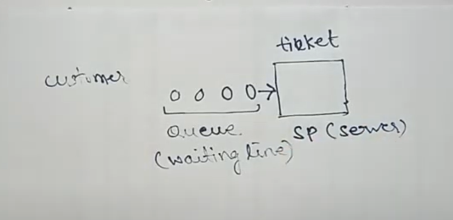
customer

Slide 3
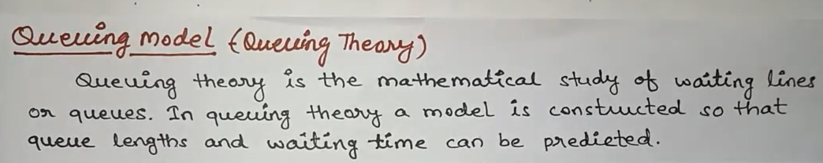

Slide 4
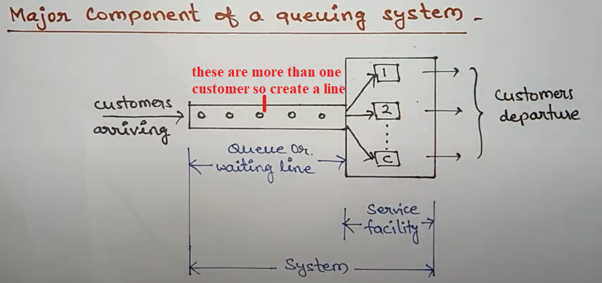
There are three major components of Queuing system (1) Customers (2) Queue (3) Service facility.
First of all customer arrive.
More than one customer arrive to create a line than it is called as Queue or waiting line.
Servers are available and to provide service to customer, than such process is known as Service facility.
Queue and service facility is the part of system.
Customer avail service and out from the system is known as customers departure

Slide 5
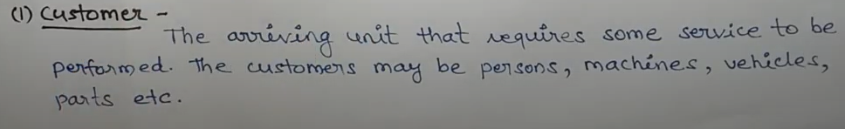
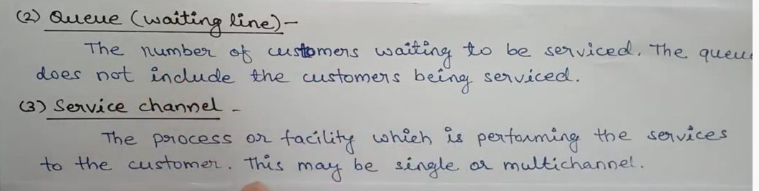
In Queue does not count customers that being served
Suppose 3 people in line and 2 in the front of cashier
So queue has only 3 customers

Slide 6
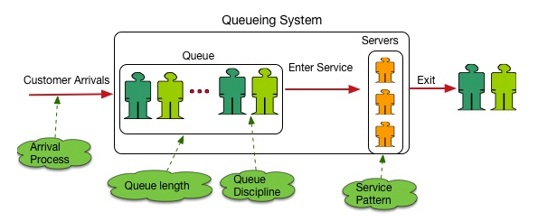

Slide 7
Arrival distribution represents the customers arrival into your system.

Slide 8
What is Queuing Theory?
Queuing Theory is a mathematical study of waiting lines, using models to show results, and show opportunities, within arrival, service and departure processes.

Slide 9
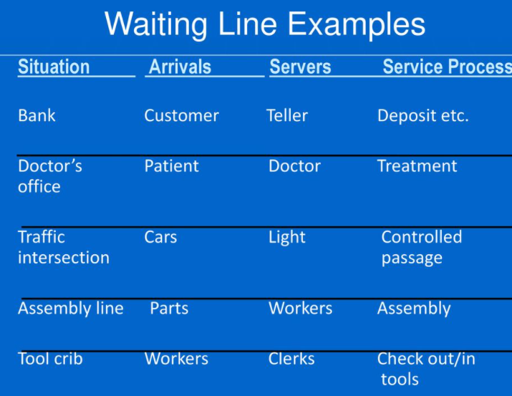

Slide 10
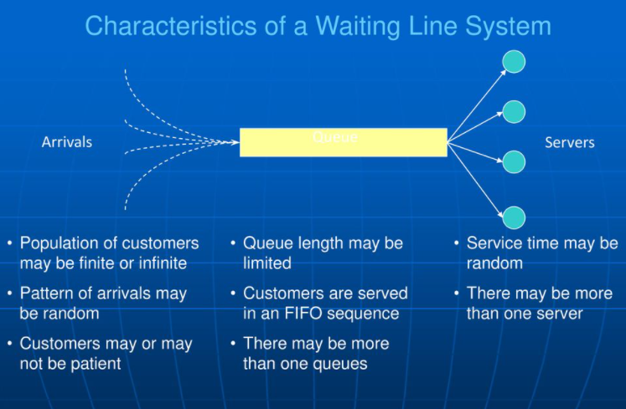

Slide 11
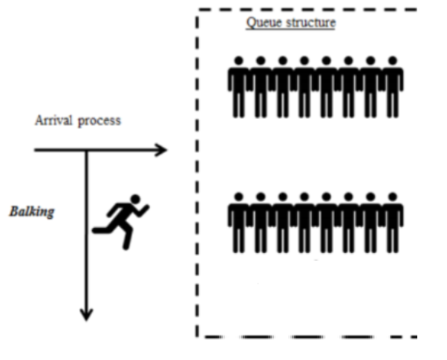
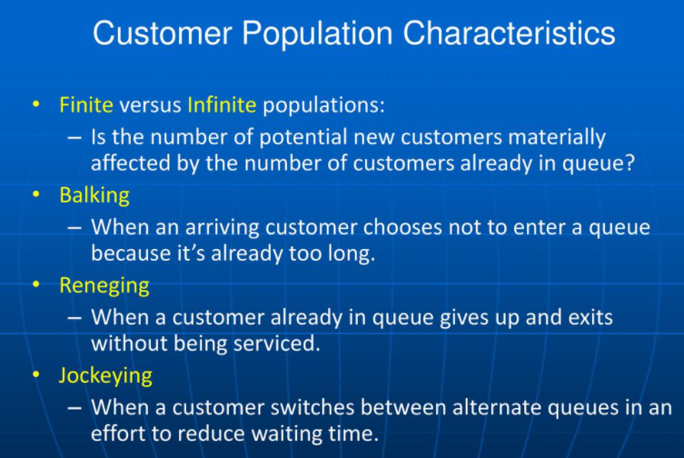
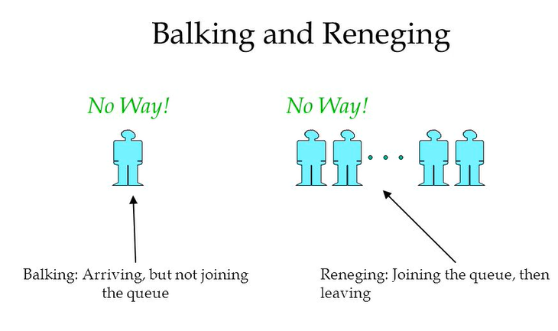
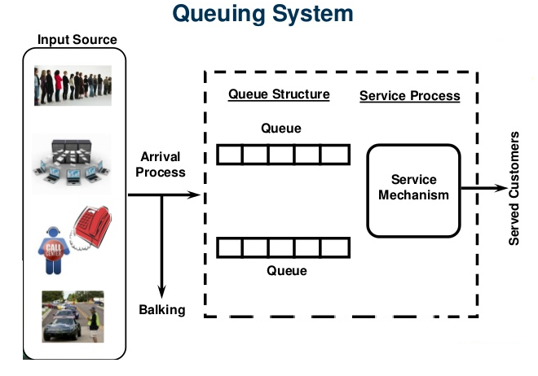

Slide 12
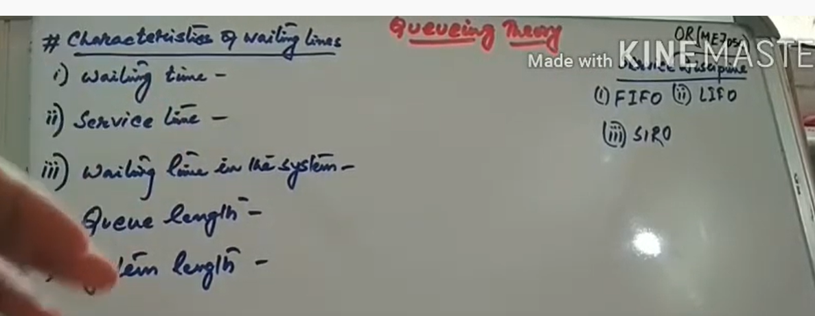

Slide 13
Queue: Queue is a line of people or vehicles waiting for something. OR Waiting line is called Queue.
Arrival: 1 Person, Machine, Part, etc. that arrives and demands service is called an Arrival.
Queue Discipline: Rules for determining the order that arrivesls receive service.
Channel: Number of servers is called Channel.
Phase: Number of steps in service is called as Phase.

